Slide 1
Alternative Classification Algorithm

Slide 2
The Basic Flow ML Algorithms
Predict or Inference
hypothesis function
Error or Loss
Cost function
Train or Learn
Gradient Descent function
Notes:
hθ​(x)=zigmoid(θ0​+θ1​x1​+θ2​x2​+θ3​x3​+⋯+θn​xn​)​
In order to develop intuition about this function, we can think about \theta_0θ0​ as the basic price of a house, \theta_1θ1​ as the price per square meter, \theta_2θ2​ as the price per floor, etc. x_1x1​ will be the number of square meters in the house, x_2x2​ the number of floors, etc.
Types of math used:
Linear algebra to do mainly matrix math, Statistics
Statistics provide many ways to measure Error, Loss or Cost
Calculus used with Gradient Descent
Provide example of how you go through a model,
Guess the answer
See how well you guest
Adjust the Theta

Slide 3
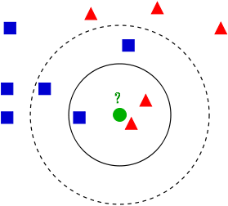
KNN - K Nearest Neighbors
KNN is an ML algorithm that classifies new data points, by a measure of distance, to its K nearest neighbors — in the existing data.
Class A
Class B
K = 3 ——
K = 5 - - - -
New Data Point
Notes:
KNN can be used for classification — the output is a class membership (predicts a class — a discrete value).
An object is classified by a majority vote of its neighbors, with the object being assigned to the class most common among its k nearest neighbors.
It can also be used for regression — output is the value for the object (predicts continuous values). This value is the average (or median) of the values of its k nearest neighbors.

Slide 4
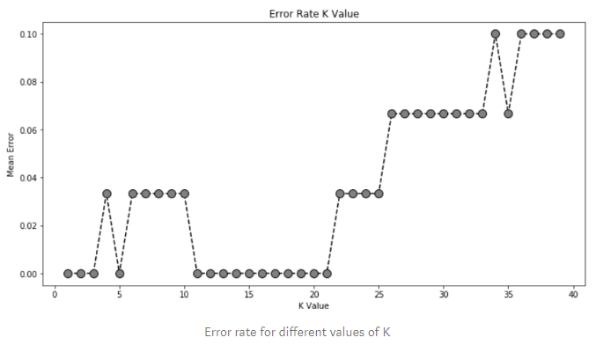
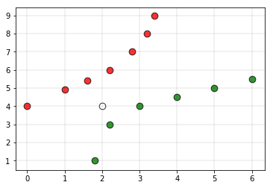
KNN Considerations
Choosing K: A problem all of its own. Best to try different numbers of K and compare the error rates, choose the number of K which has the least error rate.
Rule of Thumb: k < sqrt(n) , n = total # of samples
Weights: Give more weight to the points which are nearby and less weight to the points which are farther away
Green or Red?

Slide 5
KNN Strengths
Simple and intuitive
Can be applied to any type of distribution
Great classifier if sample size is large.

Slide 6
KNN Weaknesses
Requires a large sample size
Slow to classify.
Need to calculate and compare distance from new example to all other examples in the sample space.
Then, compare example to the k nearest points
Choosing size of K can be tricky
Notes:
The larger you make k, the more smoothing takes place, and eventually you will smooth so much that you will get a model that under-fits the data rather than over-fitting it

Slide 7
K-nearest neighbors Resources
Online Resources:
K-nearest neighbors video explanation
Weighted K-nearest neighbors explanation
K-nearest neighbors Implementation
Documentation:
Scikit-Learn K-nearest neighbors documentation

Slide 8
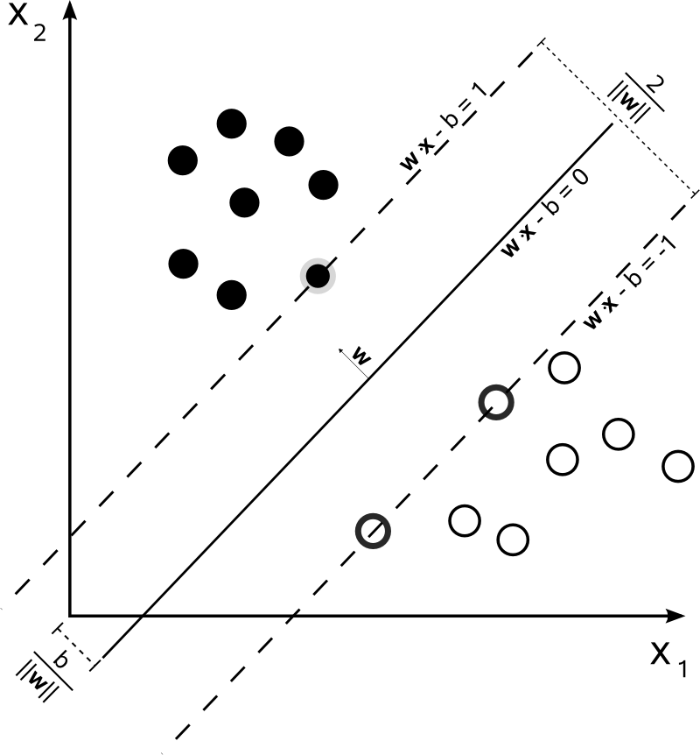
Support Vector Machines
ML algorithm that maps a training set onto a feature space and divides points into classes with a “hyperplane” w.
Support vectors maximize the margin around the hyperplane
Require EXTENSIVE tuning of a “kernel” function.
SVMs classify new points based on what side of the dividing hyperplane they land on.
Notes:
Hyperplane because it can exist in a 3 Dimensional Feature space as a plane,
In 2d Space, hyperplane is just a line.
Support Vectors: Try to find the ideal position for the separating hyperplane. Require EXTENSIVE tuning.

Slide 9
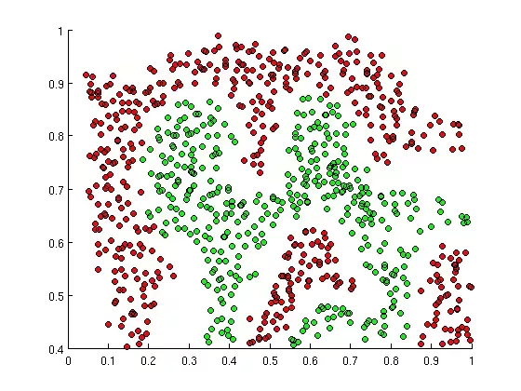
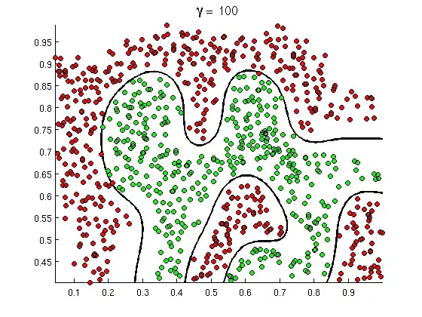
SVMs in Action
SVM

Slide 10
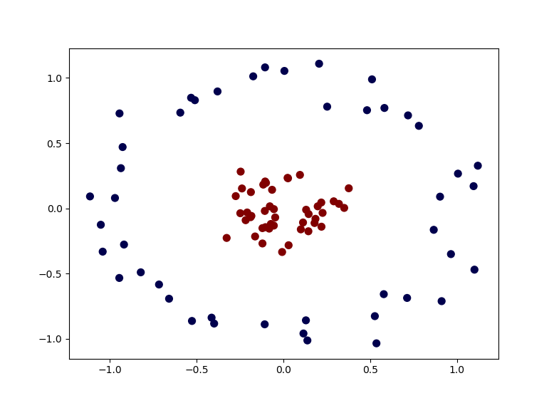
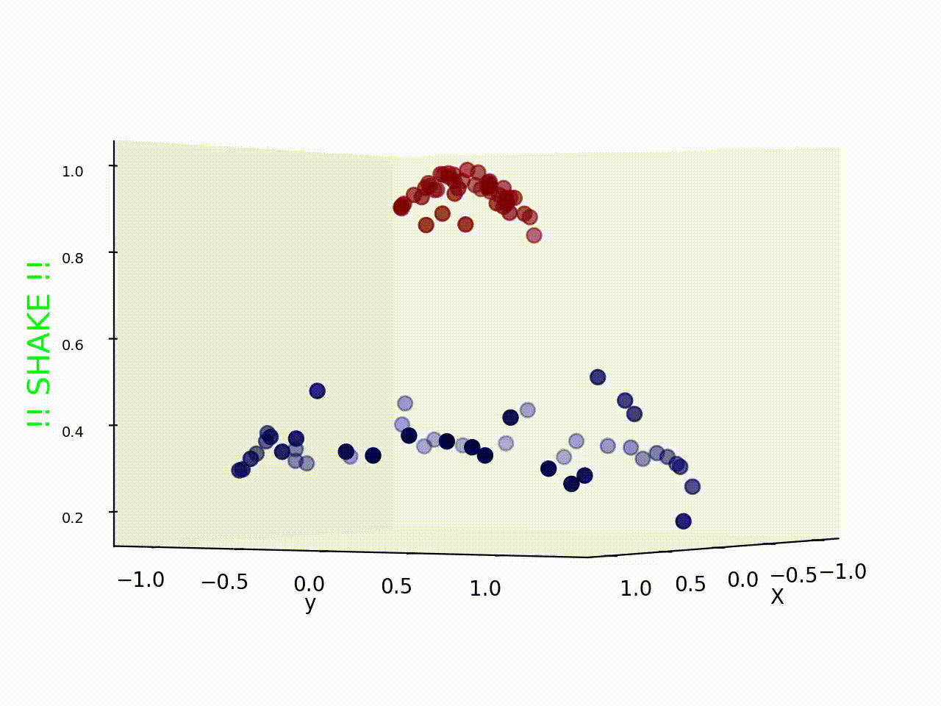
SVM Strengths
Among the most accurate models in Machine Learning.
Can handle non-linear relationships,
Tune kernel parameter to prevent overfitting.
Can deal very effectively with high-dimensional data with something called the “kernel” trick.
Kernel trick reference
kernel trick
Notes:
A shame since its so “expensive” to run.

Slide 11
SVM weaknesses
Both Training and Testing are SLOW
Don’t perform as well with Multi-class data.
Ex: Iris dataset
Kernel function requires extensive tuning.
Requires a lot of memory and processing power.

Slide 12
SVM References
Online Resources:
SVM Explanation Video
Kernel Trick Explanation
Documentation:
Scikit-Learn SVM Reference
Scikit-Learn SVM Classification Reference

Slide 13
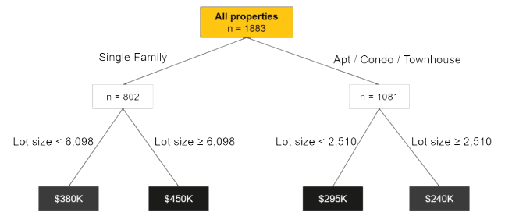
Decision Tree Algorithms
Decision trees model data as a "tree" of hierarchical branches. They make branches until they reach "leaves" that represent predictions.

Slide 14
Decision Tree Algorithms
Unfortunately, decision trees suffer from a major flaw as well. If you allow them to grow limitlessly, they can completely "memorize" the training data, just from creating more and more and more branches.

Slide 15
Tree Ensembles
Ensembles are machine learning methods for combining predictions from multiple separate models.
They allow us to take advantage of the flexibility of decision trees while preventing them from overfitting the training data.
Two most common methods for ensembling are Bagging and Boosting.
Notes:
combines several decision trees to produce better predictive performance than utilizing a single decision tree.
The main principle behind the ensemble model is that a group of weak learners come together to form a strong learner.

Slide 16
Tree Ensembles - Bagging
Bagging attempts to reduce the chance of overfitting.
It trains a large number of "strong" learners in parallel.
A strong learner is a model that's relatively unconstrained.
Bagging then combines all the strong learners together in order to "smooth out" their predictions.
Notes:
Bagging, short for bootstrap aggregating, is a general technique for combining the predictions of many models.
While it can be used to aggregate the outputs of any type of regression or classification model, bagging is usually applied to decision trees.

Slide 17
Tree Ensembles - Boosting
Boosting attempts to improve the predictive flexibility of simple models.
It trains a large number of "weak" learners in sequence.
A weak learner is a constrained model (i.e. you could limit the max depth of each decision tree).
Each one in the sequence focuses on learning from the mistakes of the one before it.
Boosting then combines all the weak learners into a single strong learner.
Notes:
Boosting is another ensemble technique to create a collection of predictors.
In this technique, learners are learned sequentially with early learners fitting simple models to the data and then analyzing data for errors.
In other words, we fit consecutive trees (random sample) and at every step, the goal is to solve for net error from the prior tree.

Slide 18
Tree Ensembles
Ensembling is a general term, but when the base models are decision trees, they have special names: random forests and boosted trees!

Slide 19
Decision Tree Algorithms
Random Forests
Random forests train a large number of "strong" decision trees and combine their predictions through bagging.
There are two sources of "randomness" for random forests:
Each tree is only allowed to choose from a random subset of features to split on (leading to feature selection).
Each tree is only trained on a random subset of observations (a process called resampling).

Slide 20
Decision Tree Algorithms
Random Forests
In practice, random forests tend to perform very well right out of the box.
They often beat many other models that take up to weeks to develop.
They are the perfect "swiss-army-knife"algorithm that almost always gets good results.
They don’t have many complicated parameters to tune.

Slide 21
Decision Tree Algorithms
Boosted Trees
Boosted trees like the gradient boosting algorithm trains a sequence of "weak", constrained decision trees and combine their predictions through boosting.
Each tree is allowed a maximum depth, which should be tuned.
Each tree in the sequence tries to correct the prediction errors of the one before it.

Slide 22
Decision Tree Algorithms
Boosted Trees
In practice, boosted trees tend to have the highest performance ceilings.
They often beat many other types of models after proper tuning.
They are more complicated to tune than random forests.

Slide 23
Decision Tree Resources
Online Resources:
Decision Tree Video Explanation
Gradient Boosting Video Explanation
Random Forest Video Explanation
Documentation:
Scikit-Learn Gradient Boosting Documentation
Scikit-Learn Random Forest (Bagging) Documentation

